Slide 1
“It Became Real”: How a Community-Engaged Project Made Research Personal
Alex Nichols (she/they), Communication
Dr. Carrie Rodesiler (she/her), Assistant Professor of English
& Assistant Director of the Writing Center

Slide 2
“I began this project with a very closed mindset. I don’t like old people very much, and I had my own presumptions on today's veterans in general . . . [but] when [he] was telling his stories, it was like I was there. He had 100% of my attention . . . My partner and I forgot about collecting research, we were completely emersed in the story. We never interrupted him, we didn’t want to.”

Slide 3
Community-Engaged Pedagogy
Also referred to as service-learning
Disrupts the practice of teaching writing in the classroom, a context that is both singular and “peculiar” (Bacon, 2000, p. 589).

Slide 4
Agenda
Turn & Talk (Part 1)
Perspective #1: Teaching (Carrie)
Turn & Talk (Part 2)
Perspective #2: Learning (Alex)
Turn & Talk (Part 3)
Q & A

Slide 5
Turn & Talk
Goal setting: Introduce yourself and share what you hope to learn today (e.g., I want to design a community-engaged project, I have already implemented a project but want to learn more, etc.)

Slide 6
Perspective #1: Teaching (Carrie)
Veterans Oral History Project
Preparation
Research Essay
Poster
Service

Slide 8
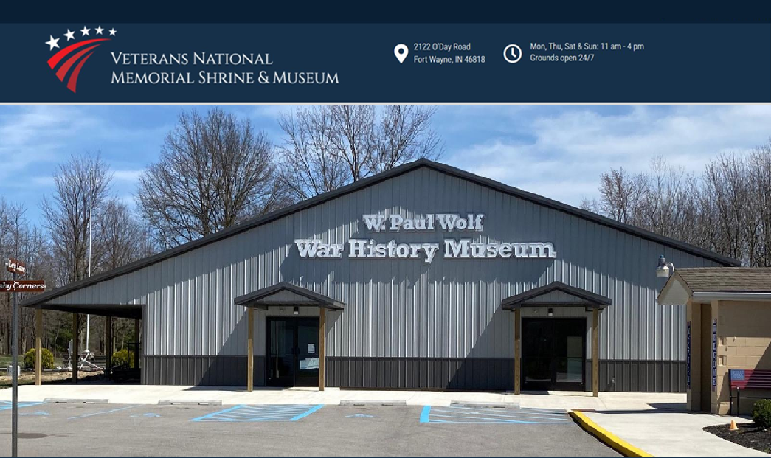

Slide 9
Explore museum and grounds
60-minute interview
Lunch with veterans
Service

Slide 11
Requirements
five- to seven-page essay, five secondary sources, and one primary source.
Prompt
“Your goal for this assignment is to write an exploratory research essay wherein you narrate your personal research journey, including pivotal moments of learning along the way.”

Slide 13
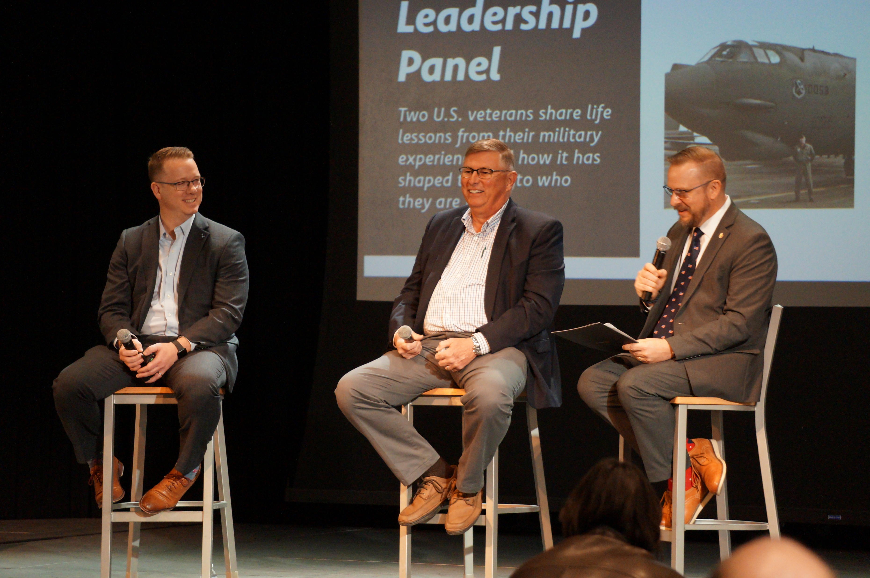
Takeaways & Implications
Spin-off projects
Student engagement
Community partner
Assessment
Support

Slide 14
Turn & Talk
Check-in: As you think about community-engaged pedagogy in your own courses, what take-aways have emerged so far?

Slide 15
Perspective #2: Learning (Alex)
Before the interview
Secondary research
Provided materials
Introduction to discourse community
Practice interview with a veteran

Slide 18
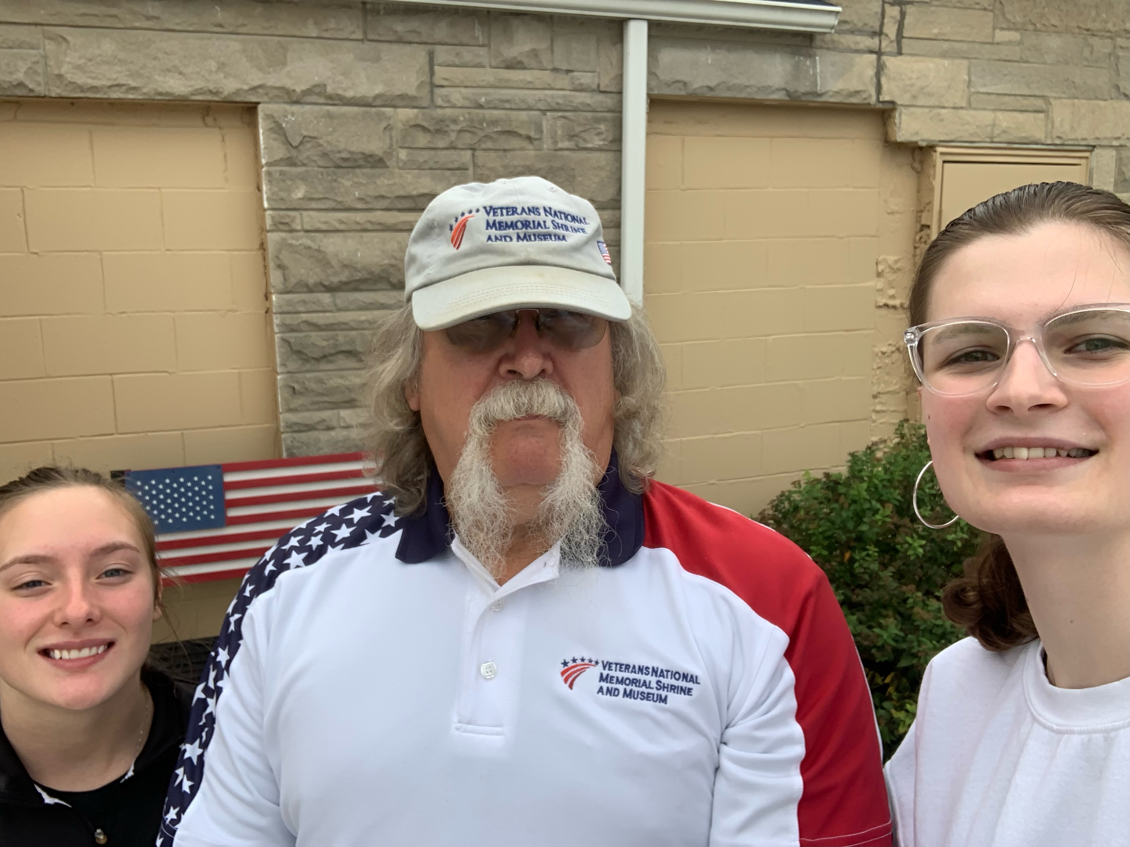
Perspective #2: Learning (Alex)
During the interview
Primary research
Project partner
Location
Veteran
Cultural artifact

Slide 19
“He wanted to talk to us, he wanted to tell us the things that he did, the things that he is proud of. Suddenly, this interview went from ‘it is just an assignment’ to a sort of deeper understanding of life itself.”

Slide 20
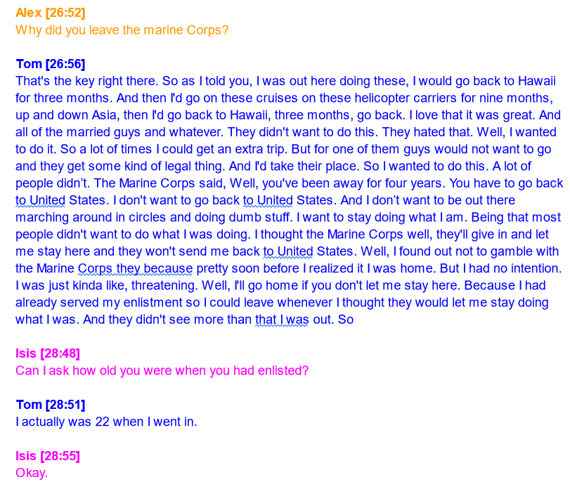
Perspective #2: Learning (Alex)
After the interview
Reflection
Growth
Review of transcript
Paper/Poster

Slide 21
“At first, it was just another assignment, another grade for the gradebook, until it highlighted one of my biggest flaws with my writing and my thinking – I let myself believe what others had told me. I had let those impressions dictate how I went into the interview and into my research.”

Slide 22
Takeaways & Implications
From class
Sources
Materials
Language
By chance
Good partner
Driven
Experience

Slide 23
Turn & Talk
Wrap up: Recall your learning goal for today. Were you successful? What are your next steps related to community-engaged projects?

Slide 24
Questions?

Slide 25
Contacts
Carrie Rodesiler carodesiler@indianatech.edu
Alex Nichols canichols01@indianatech.net

